Slide 1

BANK PERSONAL LOAN
Pickle AI

Slide 2
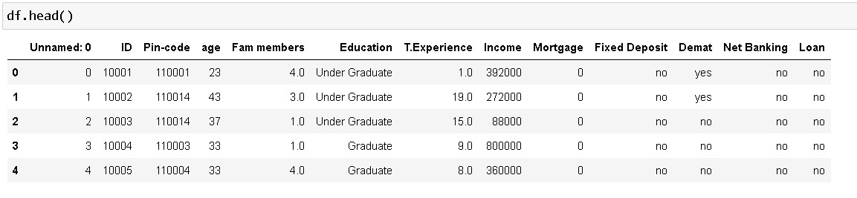
13 columns and 5000 rows

Slide 3
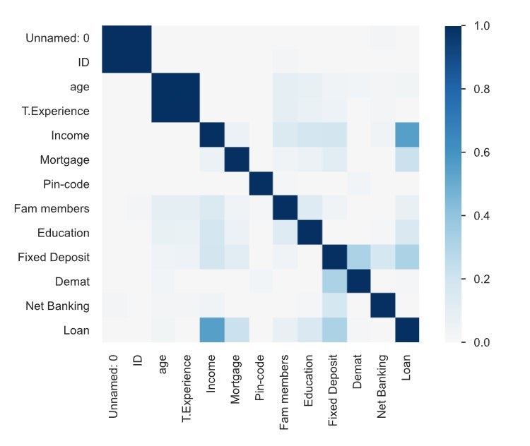
Correlation
Loan has correlation around 0.6 to Income. Which means people having high income tend to take loan more as compared to those having low income.
On the other hand Mortgage and Demat are correlated between 0.4 and 0.2 to Loan
At last, Education and Fam members are slightly correlated to Loan i.e., between 0 and 0.2.
Since only five columns are deciding factor to predict loan so, we will apply our Feature Engineering to these respective columns.

Slide 4
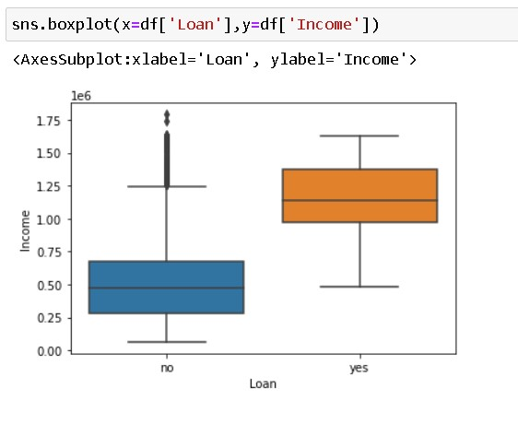
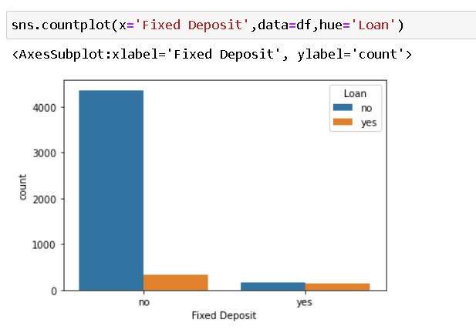
Further Analysis
Loan vs Income
Fixed Deposit vs Loan
The boxplot between Loan and Income clearly shows that people who have taken Loan, mostly have average income 1.2e6.
This bar graph clearly shows that people are more likely to take Loan who already have Fixed Deposit. As,It is evident from the ratio who have taken to those who have not.

Slide 5
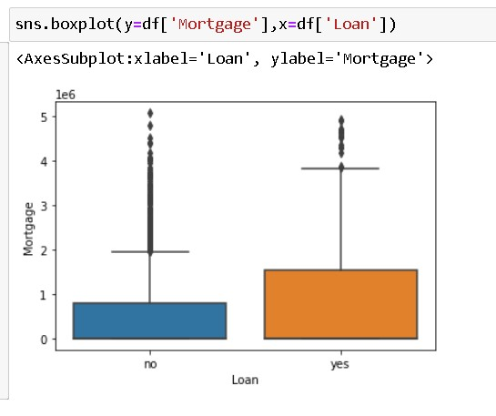
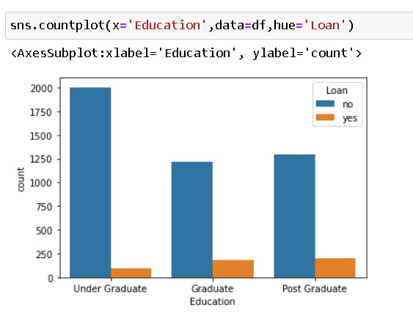
Loan vs Mortgage
Education vs count

Slide 6
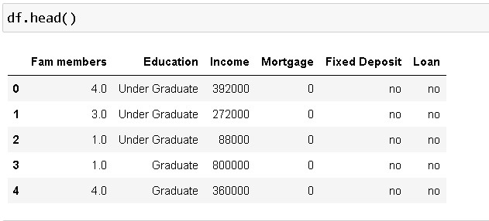
5 mostly affected columns for Personal Loan and 5000 rows

Slide 7
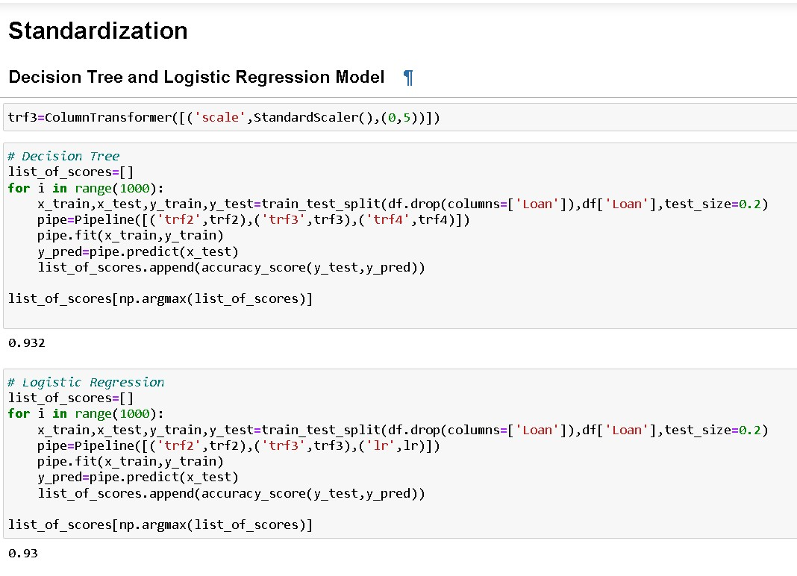
Model
Since we have categorical column like Education, Fixed Deposit so, we will use One hot encoding for building model.
Feature scaling like Normalization and Standardization are being applied to bring all columns on to same page.
Used two algorithms to predict the Loan i.e., Logistic Regression and Decision Tree classifier.
Finally used sklearn Pipes to build the model.

Slide 8
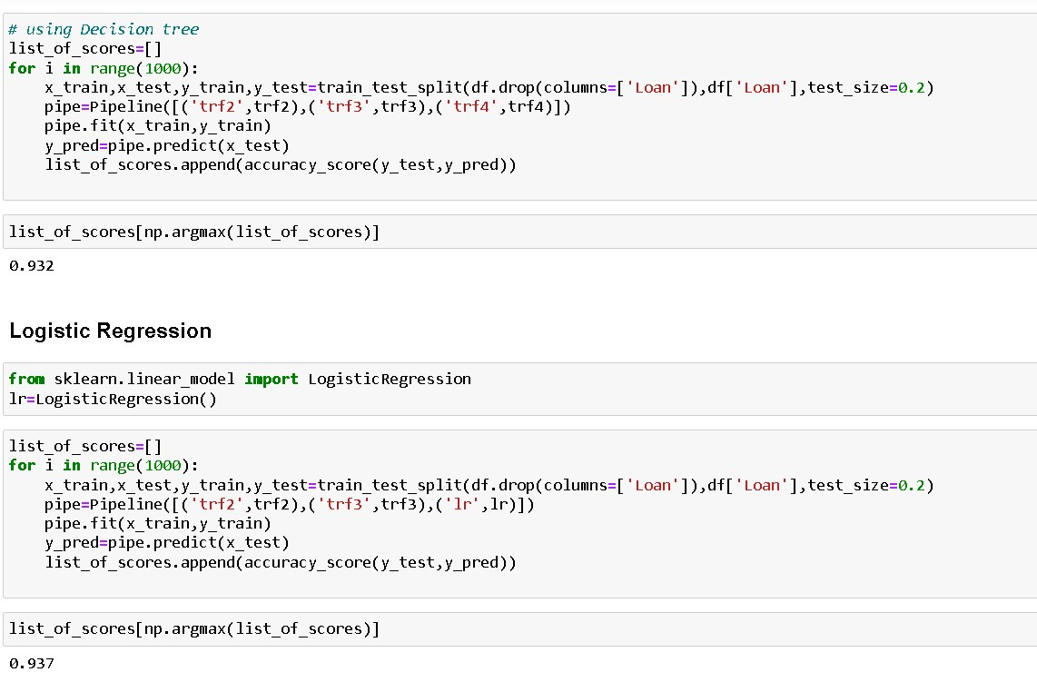
Model And Result
It is clear from both slides that Logistic Regression performs well with accuracy score of about 93.7% .
So, Logistic Regression is better as far as prediction of Loan is concerned.
Feature Scaling - Normalization

Slide 9
THANK YOU
Submitted by
Tapan Kumar

